Slide 1
chance

Slide 2
Fortune telling and meditation
Examples: Tarot, I Ching, Astrology
Introduce chance operations into a system of signs
Results are “meaningless”
But we give them meaning after the fact

Slide 3
there is no noise

Slide 4
Chance operations
Fancy term for “randomness”
A way of taking your ego out of the loop
Get past your preconceived notions
Creating surprise
Creating juxtapositions that can create new meaning for you
Could you draw a random line?
A way of automating decisions you don’t want to make
Generating a terrain for
A way of automating decisions you can’t make
Interactive art – the artist isn’t there to make the decisions

Slide 5
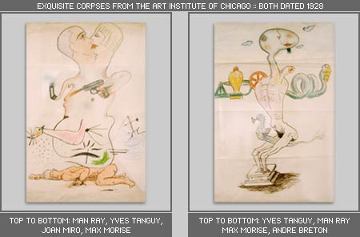
Exquisite corpse
The surrealists used a variety of unusual composition techniques
Automatic writing
Dreams as source material
Chance operations
Why?
They were followers of Freud
They saw the conscious mind as representative of the ills of society (repression, war, exploitation)
Unlock the unconscious
Escape the sources of repression
Recover a more “natural” state of the psyche
Open oneself up to the possibility of delightful coincidence
Source: http://anexquisitecorpse.net/explanation.shtml

Slide 6
John Cage, 4’33”
(excerpt)

Slide 7
what did you hear?

Slide 8
What the heck was that about?
Cage wanted people to listen to silence around them with the attitude they bring to a concert
Listening is an active process of making meaning
We can find rhythms in the sound of someone speaking
Or hear harmony in a power drill
Cage believed these could be just as musical as a symphony

Slide 9
Okay, but what does this have to do with chance operations?
Silence isn’t silent
It’s filled with sound
People walking down the hall
The vibration of the HVAC units
People giggling
People shifting uncomfortably in their chairs
All of these can be heard as music
If you don’t believe me
Try sampling it and giving it to a DJ

