Slide 1
HELEN DARMAWAN
Music Educator

Slide 2
I was born in Jakarta, Sept 11, 1979
Jakarta Skyline

Slide 3
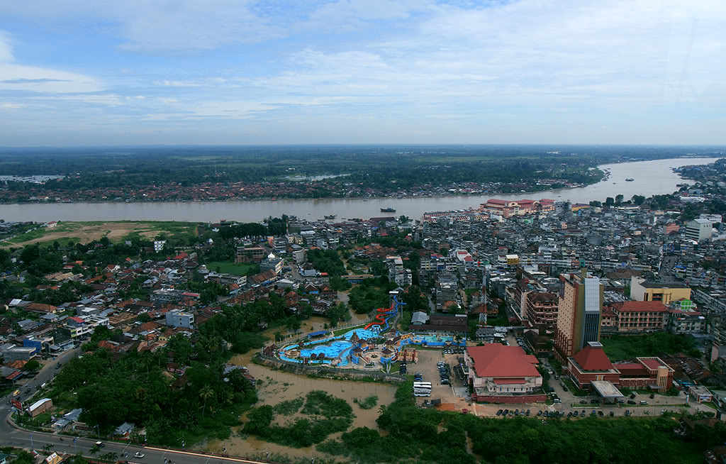
Here’s where I live
JAMBI PROVINCE (Approx. 1 hour flight from Jakarta)

Slide 4
EDUCATIONAL BACKGROUND

Slide 5
YEAR 1 - 12
1986 – 1992
IPEKA TOMANG ELEMENTARY SCHOOL, JAKARTA
1992 – 1995
IPEKA TOMANG JUNIOR HIGH SCHOOL, JAKARTA
1995 – 1992
ABDI SISWA SENIOR HIGH SCHOOL, JAKARTA

Slide 6
COLLEGE & UNIVERSITIES
1998 – 2001
NANYANG ACADEMY OF FINE ARTS, SINGAPORE
(Majoring in Piano Performance – Received Diploma in Music)
2002 – 2003
THE UNIVERSITY OF KANSAS, USA
(Majoring in Piano Performance – Received Bachelor of Music)
2014 – Present
TARLETON STATE UNIVERSITY, USA
(Majoring in Music Education)

Slide 7
AWARDS & SCHOLARSHIPS
Student Assistance Scholarship, Nanyang Academy of Fine Arts, Singapore (1999 – 2001).
2nd Prize, Songwriting Competition, National University of Singapore, Singapore (2000).
Best Achievement Award, Nanyang Academy of Fine Arts, Singapore (2001).
Tse Sai Ying Best Performing Award, Nanyang Academy of Fine Arts, Singapore (2001).
Dick Smith Scholarship, Tarleton State University, Texas, USA (2015).

Slide 8
WORKING EXPERIENCE

Slide 9
1998 – PRESENT
PRIVATE MUSIC TEACHER, SINGAPORE & INDONESIA
2000 – 2001, 2003 – 2006
YICHA MUSIC STUDIO, SINGAPORE
2007 – PRESENT
ST. CECILIA MUSIC SCHOOL, JAMBI, INDONESIA
2011 – 2012
STELLA MARIS ELEMENTARY SCHOOL, JAMBI, INDONESIA

Slide 10
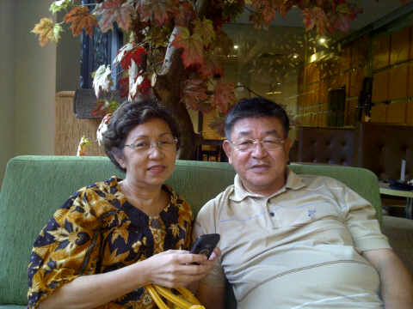
MY FAMILY
My Parents

Slide 11
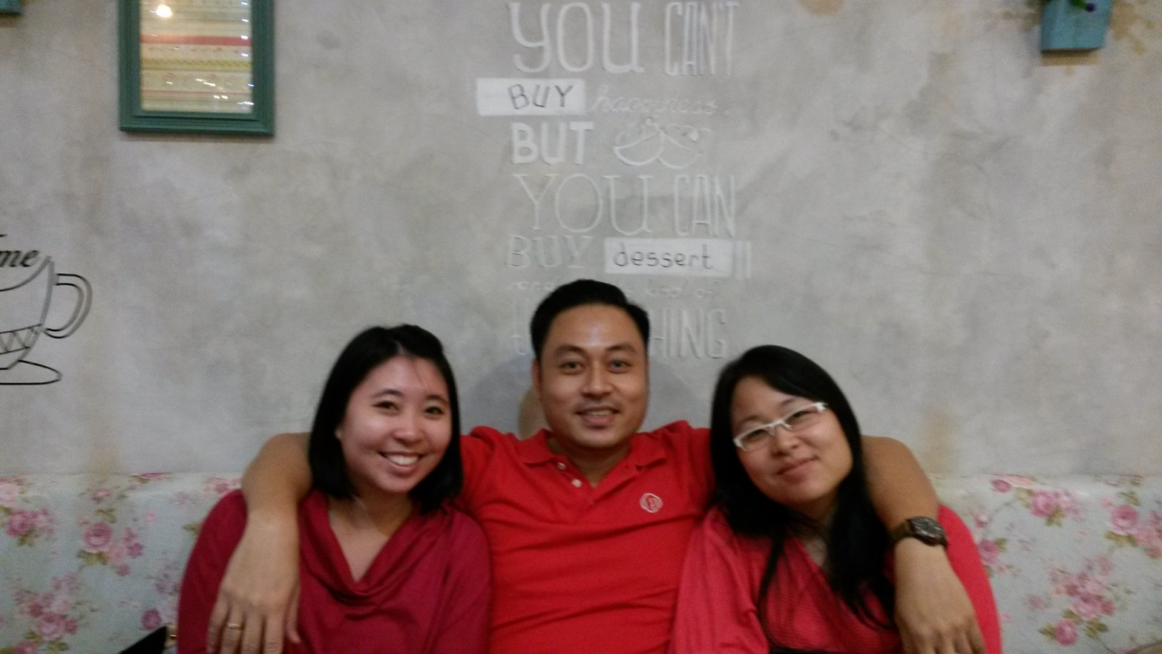
MY FAMILY
My sister and brother

Slide 12
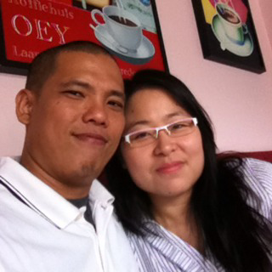
MY FAMILY
My husband (Alan) and I

Slide 13
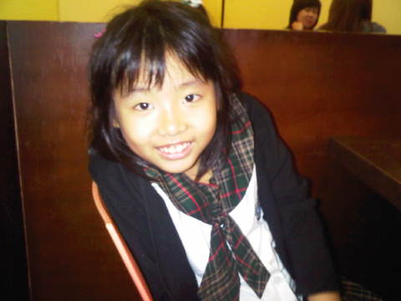
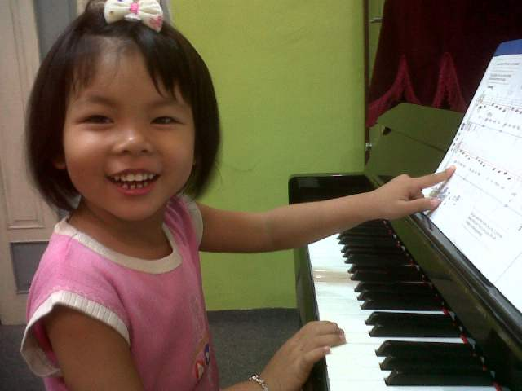
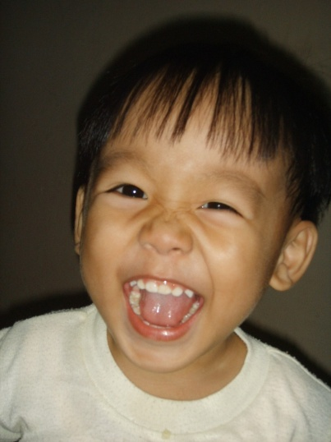
MY FAMILY
My beloved children
Alena Alexandra
Aurelia Alexandra
Amadeus Tristan

Slide 14
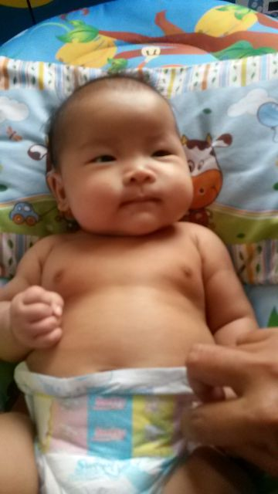
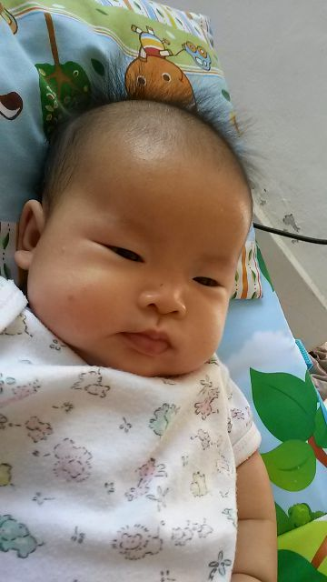
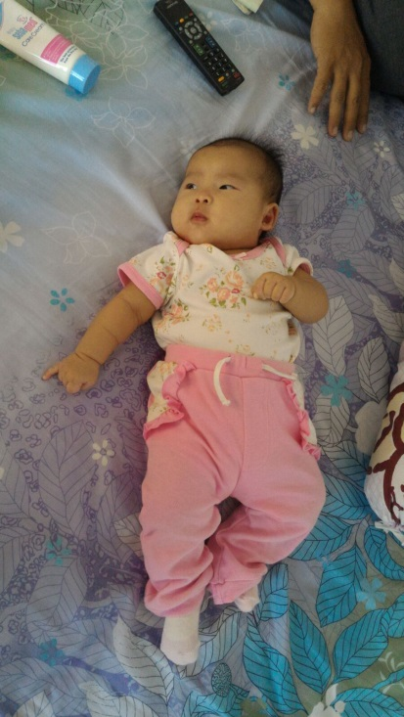
MY FAMILY
My youngest daughter
Arlynn Alexandra

Slide 15
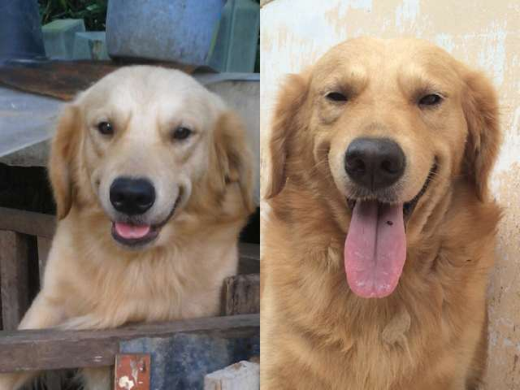
MY FAMILY
2 additional members in my family
Goldie and Monna

Slide 16
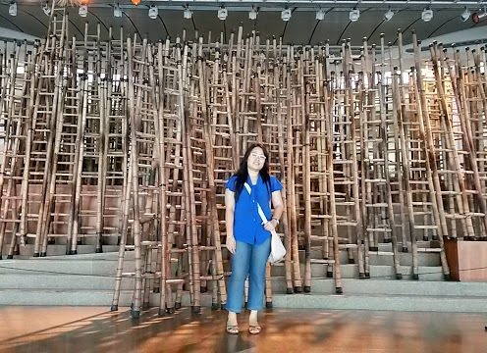
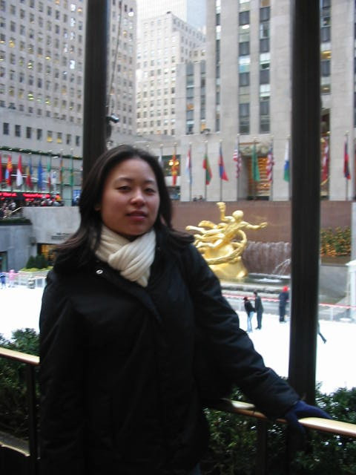
HOBBIES
TRAVELLING
At the Esplanade Concert Hall by the Bay, Singapore
Rockefeller Center, NY

Slide 17
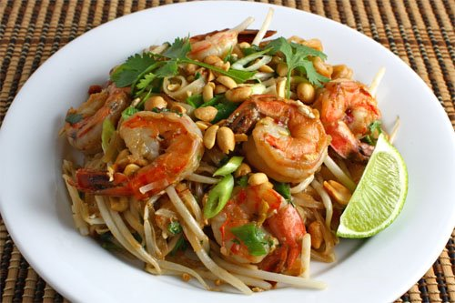
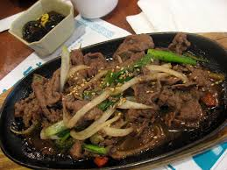
CULINARY
Phad Thai (Thai Cuisine)
Crab in Spicy Padang Sauce (West Sumatra)
Bulgogi (Korean Cuisine)

Slide 18
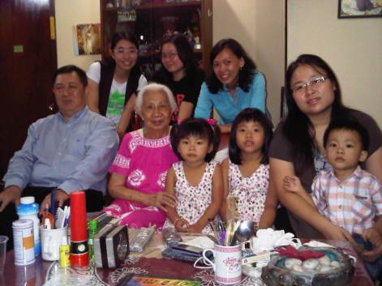
My piano teachers
I used to call her Oma Betty (Oma is a Dutch word for Granny). She just passed away last year. I studied with her since the first time I leant music until I graduated from high school. Besides teaching piano, she taught me how to become a good person with moral and integrity.
Oma Betty (in Pink) during her birthday celebration a few years ago.

Slide 19
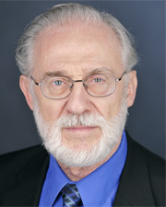
My piano teachers
He was like a father to me during my stay in Lawrence, Kansas. He took care of me like his own daughter. He encouraged me not to give up on difficult piano pieces. He always said, “Without trying, you will never know how the process is gonna be.”
Dr Richard Reber (retired Piano Professor at KU)

Slide 20
MY HOPES IN MUSIC EDUCATION
To become a good music educator in Indonesia who can impart high-quality education to Indonesian students.
To be able to make significant changes on music education system, especially in teaching young children.
And lastly, I hope that students/parents/government will start to treat music as one important element in education, as music could support other academic subjects taught in school.

