Slide 1
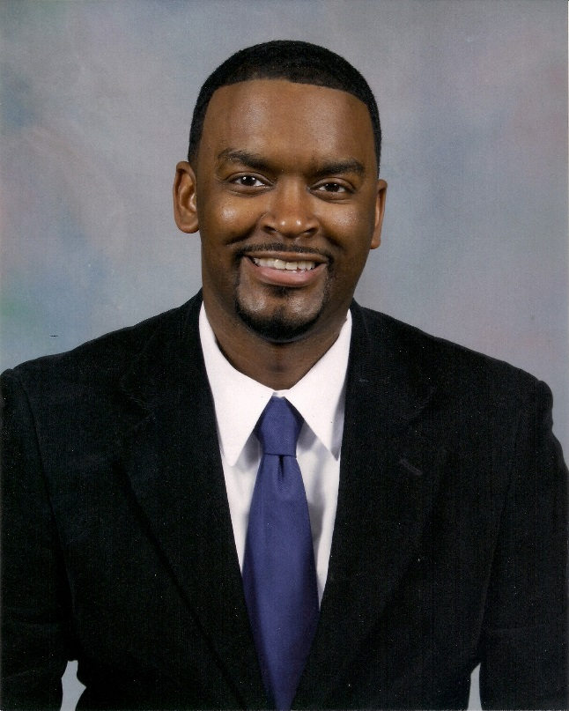
Larry Don Wade, Jr.
Subtitle

Slide 2
Musical Background and Education
I started my music career in 5th grade taking piano lessons. It was then where I received the foundation I needed to take the next step. I then went on to be in band in middle through college.
I went to Tyler Junior College & Prairie View A&M University were I received an AA-General Studies, AA-Fine Arts, & BA-Applied Music

Slide 3
Musical Experiences
*High School Drum Major
*College Drum Major
*Head Musician at Bethel Temple & True Vine- Tyler, TX
*Middle School Band Director-2yrs
*Asst. High School Director-1yr

Slide 4
Present Status
I am currently the Director of Bands and Fine Arts Department Chair at John Tyler High School, which will be 6A in the fall.
I am also a past teacher of the year, 2014.

Slide 5
Future Ambitions
I am pursing a Master’s Degree to be a better educator. I want to become better to help make my band better. I would also like to pursue teaching or being a band director on the collegiate level or as a Fine Arts Director of a District.

Slide 6
Hobbies and Extracurricular Activities
I love arranging music and playing music. I do a lot of gigging. I play the keys and sing some as well.
In my spare time I try and do nothing and relax, but I love going to and watching sports . Baseball, Basketball, and the DALLAS COWBOYS.

Slide 7
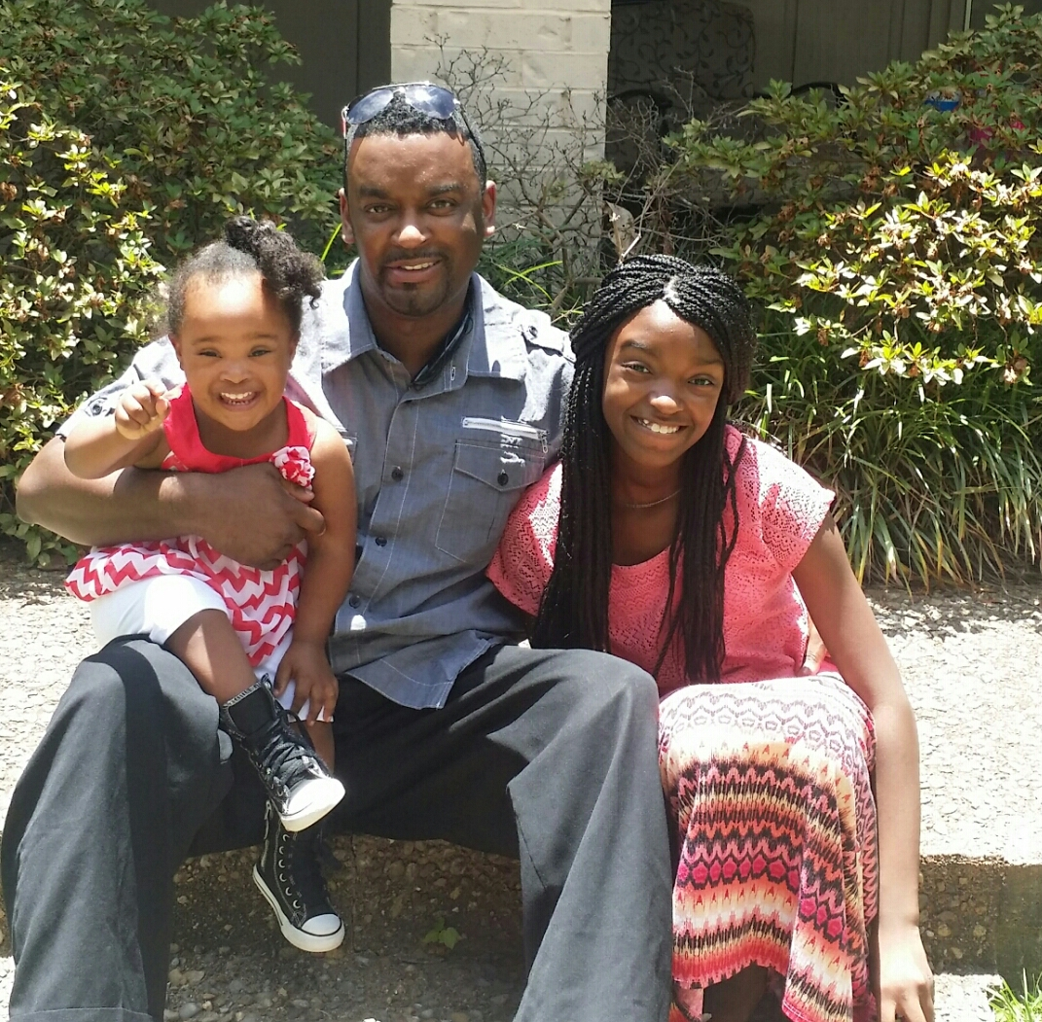
Mi Familia
I have 2 beautiful girls, 13 & 3.
My 13yr old, Taylor, is very musically inclined. She played Annie in her Middle School Play and my 3yr old, Layla, is a busy body.
My mom, dad, and sister are all in the education field and also has some music background

Slide 8
Influences
Larry Jr & Larry Sr.
Those who have impacted me in my life has been my dad, Larry Sr.; High School Band Director, John Samples; College Band Director, Late Prof. George Edwards; and my 1st Piano Teacher, Late Ruth Nixon-Sanford.

Slide 9
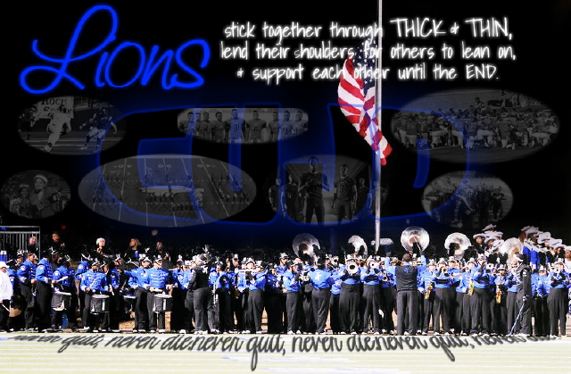
In Closing
I’m very excited for the opportunity to share a little bit about me. I look forward to enjoying to rest of this class and making the best of it.

